Slide 1


SEICHE 2022 Basic Arduino Programming
Instructor: Paul Frommeyer
www.paulfrommeyer.com
Corporate Sponsor: DXC Technology

Slide 2
Lesson Plan Overview
Lesson 1 – Intro and Setup [may require 2 classes]
Introduction to class format
Overview of lesson plan
Presentation format (monitor, camera, screen, whiteboard)
Review of microcontrollers and types of boards
SEICHE LED display architecture
ESP8266 pinout
High level architecture
Lesson 2 – Laptop operation review – Windows and Linux
Inventory of USB drives
Installation of Arduino IDE software
Installation of CH340/ESP8266 serial port drivers (Windows only)
Control panel/settings location
Home directories and folder hierarchy
Arduino file locations
Search functions
(Windows) Device Manager
(Linux) Konsole
Copying flash drive contents [critical]
Open questions and issues
IDE essentials
Starting the Arduino IDE
Basic Arduino sketch (program) structure
Loading example sketches
Loading and configuring new boards
Connecting boards
Identifying the microcontroller serial port
Linux
Windows
Lesson 3 – Libraries, Sketch structure, Serial Monitor, Variables, Binary Number System Pt1
Libraries
Sketch structure (A note on brace formatting)
The serial port monitor
Printing to the serial port monitor
Variables and the assignment operator
Binary number system Pt. 1.
Lesson 4/5 – The Binary Number System Cont. (may take 2-3 lessons)
Numerals vs numbers
Review: the base 10 system and digit place values
New: the base 2 system and digit place values
Bits and bytes and nybbles
Binary addition and subtraction
Formatting printed output
Shifting and exponents
Lesson 6/7 – Integers and Arithmetic Operators (may take 2 lessons)
The integer data type
Variables and the assignment operator
Autoincrement and autodecrement
Arithmetic Operators
Assigning arithmetic results to a variable
Bytes as data types
Lesson 8 – Communicating with Sensors
Reading a potentiometer
Reading a button
Initializing I2C sensors
Reading I2C sensors
Lesson 9 – Characters and Arrays
The hexadecimal number system
Representing characters as numbers
The ASCII character code
The char data type
Strings and character arrays
Lesson 10 – Comparison Operators
==, =>, <=
strcmp
Binary comparisons
Uploading a sketch to the microcontroller
Lesson 11 – Control Structures
if-then-else
while
for-next
Lesson 12 – Programming the LED matrix
Initializing the SPI interface
Controlling display brightness
Lighting and clearing a single pixel
Displaying text on the LED matrix
Default fonts
Nested for-next loops

Slide 3
Lesson 4 – Expressions, Conditionals, Blocks and Functions
Part A
Statement syntax review
Arithmetic Expressions and Operators
Incrementing and Decrementing Variables
Truth Values in C++
The If-Then Statement
Brace Style and Comments
Part B
Code Blocks
Functions
Function defintions (part 1)

Slide 4
Statement Syntax Review
Statements in a C++ program execute sequentially, top-to-bottom. In this sense sketches/programs are like a food recipe.
Most statements appear on lines by themselves; this is convention. The language requires only that they be separated by whitespace (space, tab, newline). Note that newline is considered whitespace.
All statements, including assignments and defintions, must be terminated with a semicolon (the C++ counterpart to an English period.)
Constants are numbers which appear “as themselves” in C++ code, e.g., 3.1415926
Variables are containers for numbers or other data.
Variables must be declared as a particular data type.
The setup() and loop() sections begin and end with open { and close } braces, respectively.
C++ is case sensitive! An_Integer_Variable and an_integer_variable are not the same entity!

Slide 5
Brief Note On Sanitizing Data
Some of you have run into issues when directly copying text from PDF files (our lessons) into the IDE. This is due to hidden characters which get copied from the PDF and confuse the IDE. Windows is particularly prone to this
The solution is to first paste the text into a plain text editor. This strips out any hidden characters and leaves only the program code
On Windows, the tool for doing this is Notepad
On Linux (Kubuntu), the Kate text editor will work
Both can be accessed via the Start/Applications menu
For best results: copy from the PDF, paste into the editor, deselect the text, the reselect, copy, and paste into the IDE
Yes, the IDE should do this for us, but here we are

Slide 6
Brief Note On delay()
We will cover functions in more depth later
For now, know that delay() is a function which causes the processor to pause (wait) for that amount of time before continuing on in a sketch.
The syntax (formal usage rules) for delay() is: delay(number of milliseconds to wait)
It is very important to use delay statements, or some other means of slowing output, when using the serial monitor
This is because Arduino boards run fast enough that their serial output, unchecked, can overload the computer and operating system the IDE is running on
This is not a problem when running a board standalone (not connected to the IDE), only when using the Serial Monitor.

Slide 7
Arithmetic Expressions and Operators
An arithmetic expression is a combination of arithmetic operators that produces a numerical result.
Arithmetic expressions are normally used as arguments (data input) to statements, such as the assignment operator =.
The basic C arithmetic operators, as previously mentioned, are + (addtion), - (subtraction), * (multiplication), / (division), % (modulus or modulo or remainder) and ^ (exponentiation).
There are also binary operators which operate on the raw binary data that defines a constant or variable. More on those later.

Slide 8
Incrementing and Decrementing Variables
Incrementing a variable means adding to it, and likewise decrementing means subtracting from it.
C++ provides autoincrement operators which can be applied to numeric variables. These are traditionally written in postfix form (after the variable name.) They can be applied to a variable pretty much anywhere, however that can lead to chaos, so they are generally written as unique statements, with some exceptions as we’ll see.
The autoincrement variable is ++. It is used like this: some_variable_name++; Autoincrement will add one (1) to the variable it is applied to.
The autodecrement variable is --. It’s use is similar: some_variable_name--;

Slide 9
Autoincrement/decrement
Let’s watch how autoincrement works. Enter the following sketch and upload it to your board. Be sure to have the Serial Monitor open (and set for 9600 speed) to watch the output.
byte testvar = 0;
// the setup function runs once when you press reset or power up
void setup() {
// Setup port for serial monitor
Serial.begin(9600);
}
// the loop function runs over and over again forever
// so will increment testvar forever
void loop() {
Serial.println(testvar,DEC);
testvar++;
// Do not reduce delay below 250 to avoid locking up IDE or laptop
delay(500);
}
Describe your results. What is happening, and why?

Slide 10
Self-Assignment
In C++, and other languages, there is a sometimes confusing operation in which the = assignment operator is used to add the value of a variable back to itself.
The key to how this works is in the phrase “the value of a variable”.
Written out, the process works like this:
Take the value of the current contents of a variable
Then add those contents to the same variable
In program code, this looks like: a = a + 5;
It works because the value of A is taken before the arithmetic operation is performed. So if a contains the value 8, the what’s really happening is this: a = 8 + 5;

Slide 11
Self-Assignment
Let’s modify our sketch to use self-assignment instead of autoincrement. Replace the testvar autoincrement as shown below, then upload the sketch and watch the results in the monitor.
byte testvar = 0;
// the setup function runs once when you press reset or power up
void setup() {
// Setup port for serial monitor
Serial.begin(9600);
}
// the loop function runs over and over again forever
// so will increment testvar forever
void loop() {
Serial.println(testvar,DEC);
testvar = testvar + 8;
// Do not reduce delay below 250 to avoid locking up IDE or laptop
delay(500);
}
Describe your results. What is happening, and why?

Slide 12
Truth Values in C++
The C++ language has a limited concept of “truth”. This is exactly equivalent to whether a circuit is on or off.
As you might expect from previous lessons, truth for an Arduino is, then, expressed as either a zero (false) or anything else (true).
The IDE provides a “shorthand” when we need to explicitly refer to these values: TRUE is a word that is “mapped” to the number 1 FALSE is a word that is “mapped” to the number 0
Why do we care? Because all arithmetic expressions evaluate to (produce) a truth value. This is used in more advanced computer operations, and is critical for conditional expressions, which we will look at next.
So to give some simple examples:
The result of 9-9 would be false, because the result is zero
The result of 0 + 1 would true, because the result is one.
The result of 2 + 2 would be true, because it is not zero
There is also a negation operator in C++, which evaluates to the opposite of the truth value it is applied to.
The negation operator is the exclamation mark, !, and it works like this: !TRUE !some_variable

Slide 13
Conditional Operators
Because truth is so import for programming, C++ and other languages provide conditional operators, sometimes called comparison operators, which can evaluate the value of one variable against a constant, another variable, or even an arithmetic expression.
The conditional operators in C++ are:
Logical equals; this is done with a double equals sign: ==
Logical not equal; this is a negated equals sign: !=
Greater than; this is the (wait for it) greater-than sign: >
Less than; this is the (no surprise) less-than sign: <
Equal to or greater than: =>
Less than or equal to: <=
And, as you’ve already seen, a simple negation, !
Here are some examples; each expression will evaluate to true or false
10/5 == 2
some_variable > 99
one_variable != another_variable
one_variable == another_variable + 17
Note the absence of terminating ; -- these are expressions, not statements!

Slide 14
The If-Then Statement
The if-then statement is probably the most important program flow control statement in C++ (or any other language).
If-Then uses conditional expressions to determine whether a statement (or block of statements) is executed.
The formal syntax for if-then is: if (conditional expr) then statement;
Usually, the “then” is placed on a line by itself: if (TRUE) then Serial.println(“Hello World”);
But what you will most commonly see after the then is a code block (discussion later), like this: if (2+2 == 4) { Serial.println(“It works on my machine!”); }

Slide 15
If-Then – Let’s Give It A Go
Let’s modify our sketch to use if-then to reset the variable when it reaches a certain value. Update your code as shown below, then upload the sketch and watch the results in the monitor.
byte testvar = 0;
void setup() {
// Setup port for serial monitor
Serial.begin(9600);
}
void loop() {
Serial.println(testvar,DEC);
testvar = testvar + 8; if (testvar > 99) {
testvar = 0;
}
delay(500);
}
Describe your results. What is happening, and why?

Slide 16
Brace Style
The way braces are arranged in C++ is something of a religious war among programmers.
The “holy canon” style used by the original C language authors works like this, and is what you will see most often: if (TRUE) { do_something(); }
The style used by us “reformationists”, because it makes checking brace congruity oh-so-much-easier, is this: if (TRUE) { do_something(); }

Slide 17
Comments
Comments are any alphanumeric text that is completely ignored by the IDE/compiler
Arduino C++ offers two methods for including comments in code
The first you have already seen // check it out, it’s a comment!
The second has been present in C since 1972, and is useful for including large blocks of text (or commenting out large blocks of code) /* Any text you want can go between the comment delimeters. Note that the delimeters are the _inverse_ of each other */

Slide 18
Code Blocks
Code blocks are a means of grouping whole sections of code so that they can be treated as a single statement.
You have already seen this used with the if-then statement: if (TRUE) { // this is a block of code between the braces }
All program flow control statements will work with blocks
But you don’t have to use a control statement to use a block: { // A bare code block a++; }
Code blocks are pervasive in C++; programmers prefer them for control statements because they allow the easy addition or removal of other statements within the block

Slide 19
Functions
A function is a means for executing a code block from within another code block
You have already seen a whole bunch of them: setup() loop() delay();
Depending on the function, it may or may not be called (invoked) using parameters.
Parameters are data that is passed to the function, such as a time value: delay(1000);
There can be more than one, again depending on the function: some_function(parameter1, 3.1415926);
What data type the parameter(s) have, and what values they contain, are entirely dependent on the function (and what you want it to do.)

Slide 20
Function Definitions
You have already seen what a function definition looks like, because that is precisely what you’ve been doing with the setup() and loop() functions! setup() { // bunch of setup code goes here }
So the way you define a function is really simple: function_name() { // code block }
The parentheses after the function name followed by a code block are the key.
Except in very rare circumstances, functions must be declared outside the setup() and loop() functions. Declaring functions inside other functions is possible, but it is fraught due to scoping (which we are not talking about this semester) so most C++ compilers simply won’t permit it, and you’ll get errors if you try.
We will cover declaring functions with parameters in another lesson

Slide 21
Function Definitions - Excercise
So just for kicks and to show what we’ve learned, let’s move the bulk of our loop statements to a function. Update and upload, folks!
byte testvar = 0;
void setup() {
// Setup port for serial monitor
Serial.begin(9600);
}
void loop() {
Serial.println(testvar,DEC);
modifytestvar();
delay(500);
}
Void modifytestvar() { testvar = testvar + 8; if (testvar > 99) {
testvar = 0;
} }
Did it work? If not, check your braces and semicolons!

Slide 22
Formal End of Lesson 4
HOMEWORK!
Arduino Cookbook – Make sure you have read ALL of Chapter 2 and Chapter 3
A programming assignment! Yay! Write a sketch to increment a number until reaches 200, then decrement it until it reaches 0, then start incrementing it again. You can use either the ++/-- operators or selfassignment for variable updating. You’ll execute the sketch next week. Yeah, it’s a desk-checked exercise, which I hate – although feel free to use a GNU C compiler locally if you just can’t wait. ☺
In next week’s exciting episode
Arrays and strings
Functions and parameters
The for-next loop
Nested for-next loops
The binary number system (assuming I get those displays done!)

Slide 23
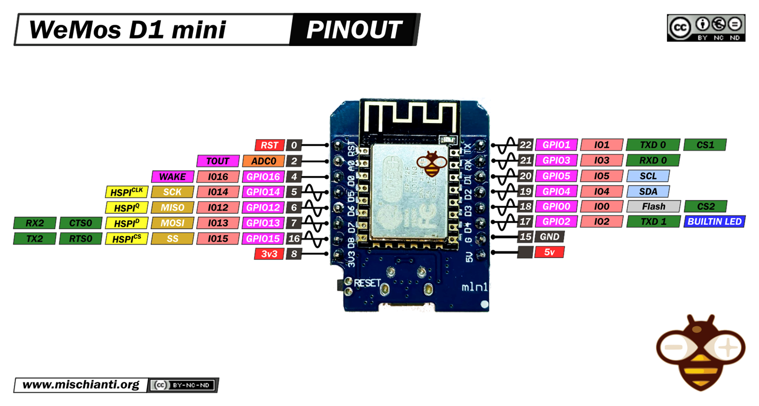
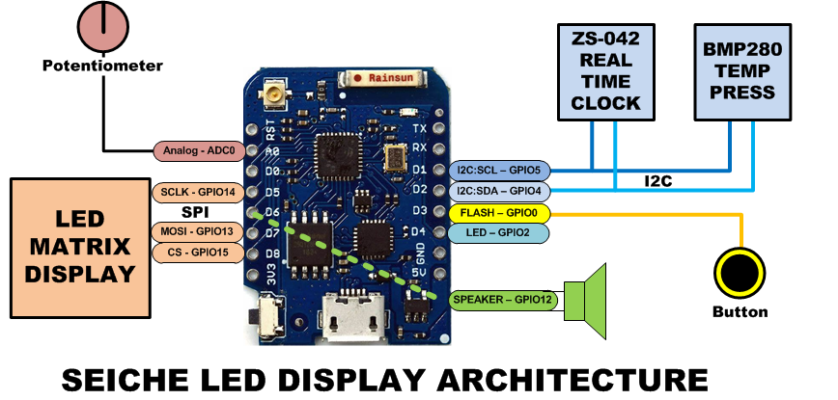
LESSON REFERENCE

Slide 24
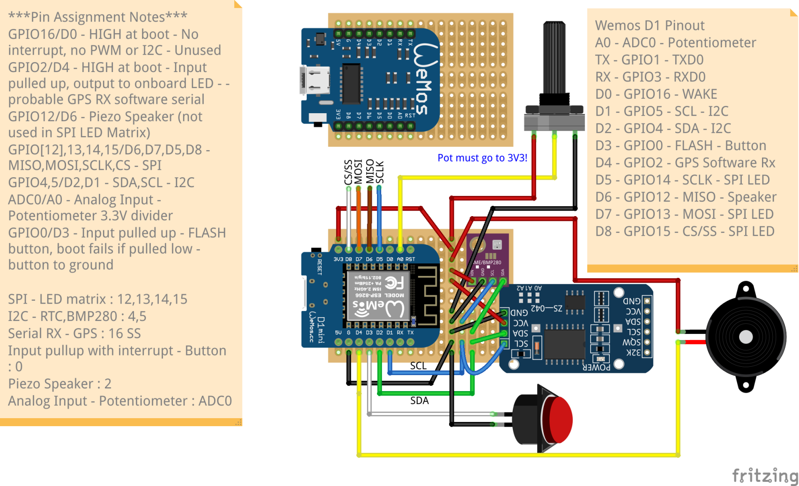
LESSON REFERENCE

